Slide 1

Notes:
Hello everyone, its lovely to see so many of you here today. We’re going to give you a short presentation to summarise our progress report which we’ve just published on our website. Not only will we cover key achievements of 2024 but also a little look ahead. The Progress Report’s foreword was written by the council’s leader, Richard Stanley. Cllr Stanley has a prior commitment today but we caught up with him at the office recently and this is what he had to say.

Slide 2


Slide 3
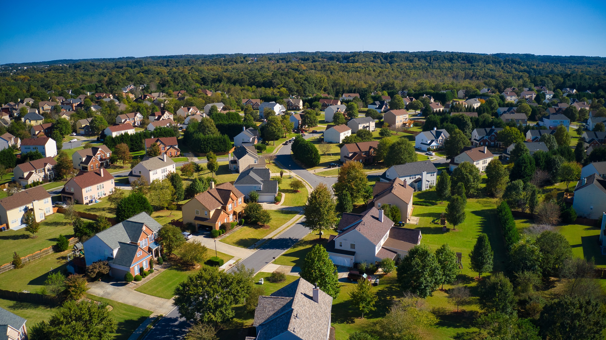

Agenda
The opportunity
Current pipeline
Transport
The political landscape
Delivery
Stewardship
Notes:
Thank you, Richard, for setting out the opportunity that we have with the Garden Communities programme. As Richard said, here’s what we’re going to talk about for the next 20 minutes or so, then we’ll break out to a more relaxed setting and we’ll be happy to chat about these and any other topics with you. We’ve been joined by friends and colleagues from various organisations here today (show of hands) who are very happy to chat, listen and explain. But before I turn to my colleagues to take us through the report, let’s introduce the Tewkesbury Garden Communities team.

Slide 4

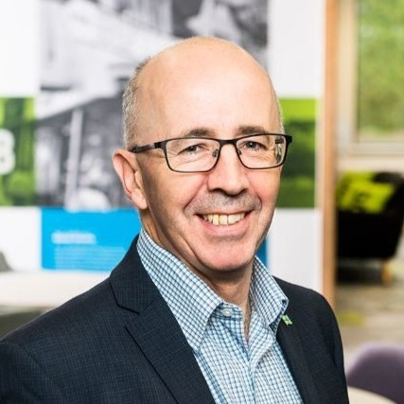
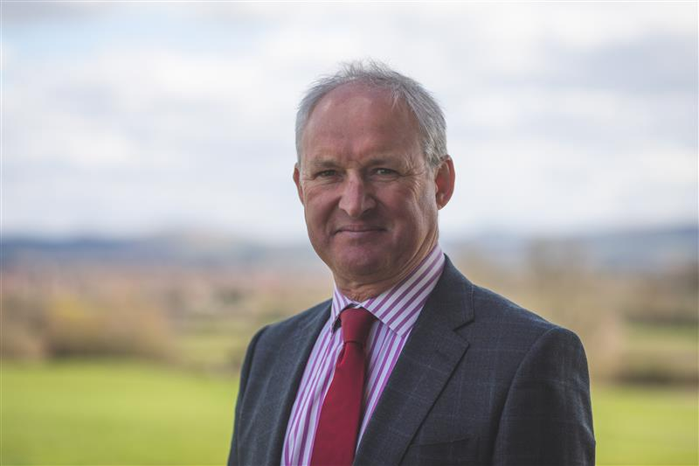
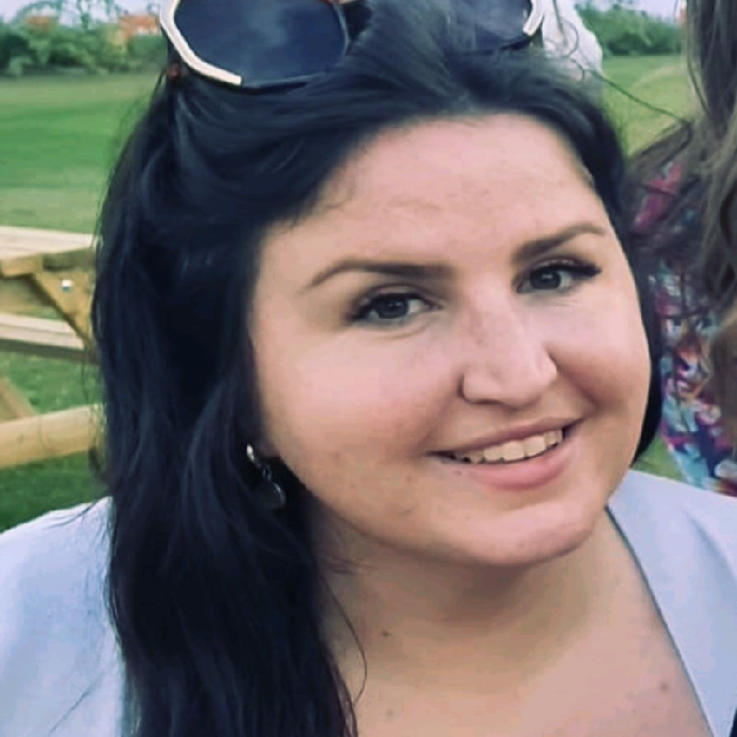
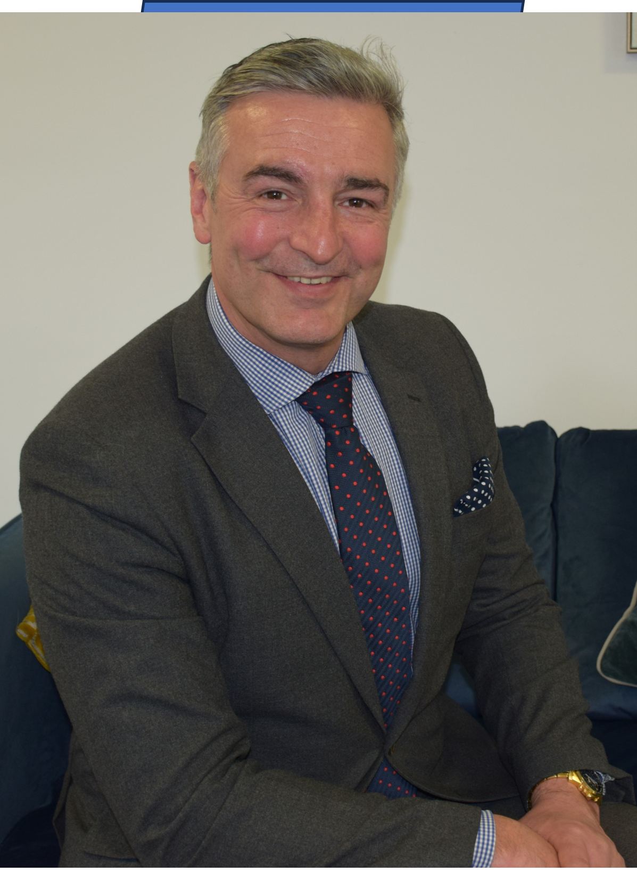
Meet the team

Slide 5
Alice
Place Development Manager
Lives: Near Cheltenham
Background: Urban Design – public and private sector
Music: Just about anything!
Notes:
Alice is often called as an expert witness in appeals where the Local Planning Authority has turned down a planning application because it doesn’t fit with the Garden Communities Charter principles and is a massive advocate for good design and getting that element right at scale. Alice is leading our work on masterplanning.

Slide 6
Neil
Programme Officer
Lives: Near Gloucester
Background: Programme and project management including Glos LEP
Music: Country since Nashville
Notes:
Neil’s the newest member of the team and brings a wealth of programme and project management experience. He was key to the launch of Cheltenham’s Golden Valley ambitions before moving to the LEP where he was involved with, amongst other things, big road improvement projects.

Slide 7
Jonathan
Associate Director
Lives: Near Tewkesbury
Background: Programme management and aerospace
Music: Anything pre-2000
Notes:
Jonathan’s the team captain and has worked around the world in a variety of programme management and aerospace roles, including time in Berlin. He’s just come back from holiday and hasn’t spotted that we’ve played a little practical joke on him with this slide!!

Slide 8
Martha
Programme Coordinator
Lives: Tewkesbury
Background: Community engagement and community funding
Music: Pop
Notes:
Martha is our programme coordinator, which means she’s responsible for bringing all our efforts together and making sure that everything is mapped out.

Slide 9
Gethin
Communications and Engagement Officer
Lives: Near Cheltenham
Background: Media relations, PR and communications
Music: Classic rock, house, classical
Notes:
And then there’s me. I turn up to meetings to find out what’s going on and then I write news stories on our website, write and respond to social media posts and occasionally am asked to stand here and introduce speakers who can tell you all about the progress we’ve made in recent months. So without further ado..

Slide 10



Guests
Gary Stephens
Michael Craggs
Notes:
And then there’s me. I turn up to meetings to find out what’s going on and then I write news stories on our website, write and respond to social media posts and occasionally am asked to stand here and introduce speakers who can tell you all about the progress we’ve made in recent months. So without further ado..

Slide 11
Agenda
The opportunity
Current pipeline
Transport
The political landscape
Delivery
Stewardship
Notes:
I’d like to bring in Neil here if I may. Neil, can you tell us about the plans for the whole Garden Communities area.

Slide 12
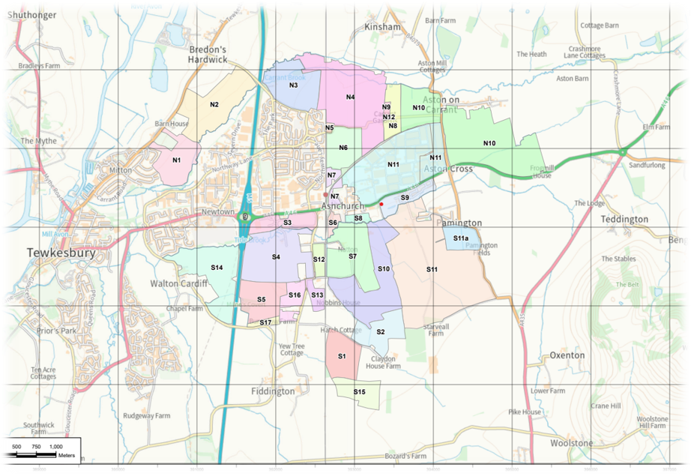
Current pipeline
Notes:
It’s worth noting that currently the land in the Garden Communities designated area has no formal planning status, however, because of a current undersupply of homes (relative to government-set targets) in the borough, significant ‘windfall’ development (i.e. planning consents which are not within a local plan) is an ongoing reality. Let’s have a look at some of these parcels of land so you can see what’s going on.

Slide 13
Current pipeline
Newland Homes
Proposal
450
Notes:
Not signed

Slide 14
Current pipeline
North Ashchurch Consortium
Proposal
2800
Notes:
Committed to the charter – signed!

Slide 15
Current pipeline
MOD St Modwen
Live application
360
Notes:
Not signed – working with the MOD as they’re a government body not supporting another government body

Slide 16
Current pipeline
Persimmon
Consented
850
Notes:
No southern area developer or landowner has yet come forward. 2025 will see the team make increasingly direct approaches for developers and land owners to sign up to the charter as we develop the southern area masterplan.

Slide 17
Current pipeline
Barratt
Consented
460

Slide 18
Current pipeline
Homedowns
Consented
30

Slide 19
Current pipeline
Tinpenny Farm
Live application
30

Slide 20
Current pipeline
Greystoke Land
Live application
175

Slide 21
Current pipeline
Robert Hitchins
Consented
120

Slide 22
Current pipeline
Robert Hitchins
Live application
140

Slide 23
Agenda
The opportunity
Current pipeline
Transport
The political landscape
Delivery
Stewardship
Notes:
Sustainable wider connectivity.
The character areas will be well connected as well as connected to Tewkesbury Town, ensuring that residents of both places are linked.
The Garden Communities will deliver sustainable travel options, to encourage journeys to be via walking, cycling or public transport.
We must see:
Focus on walking, cycling and improved access to public transport.
Communities that are compact and mixed use, allowing residents to reduce their need to travel long distances.
Attractive walking and cycle routes across the Garden Communities. Plus, better access to local schools and the town centre.
Streets designed for people, not cars. Including a maximum 20mph speed limit throughout the Garden Communities.
Promotion of cycling across the Garden Communities through safe and convenient routes, away from primary roads.
Use of data and local information to support active and sustainable travel.
Infrastructure must be delivered alongside the development of housing.
Development will support the A46 to become a more attractive route for walking and cycling.
The delivery of a strategic traffic solution to reduce existing congestion and support housing and economic growth.
Development must support improvements to Ashchurch for Tewkesbury train station to allow for increased usage as well as improved links to the train station.

Slide 24

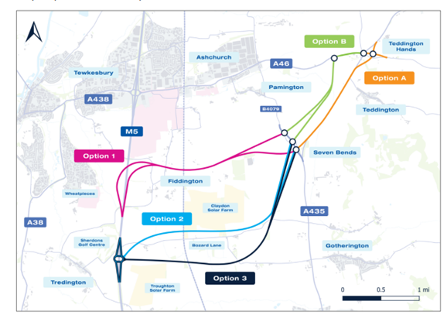
Transport
A46 and M5 J9a
Over 1,000 responses
90% say it’s necessary
Delivery - 2030-35
Northway
Will any of the surrounding area infrastructure be improved or built before the development starts?
Notes:
The engagement process included three public events held at various locations within the local area, attracting over 450 attendees. GCC received 1,085 responses to their public engagement questionnaire, which drew responses from a wide geographical area. Postcode analysis revealed a strong level of engagement from both residents and regional A46 users.
A full analysis of the public engagement feedback is underway. This analysis will inform the next stage of the scheme's development. GCC plans to publish a comprehensive Report on Public Engagement, including the analysis in 2025.
Refinements to the six options presented at public engagement will be considered in the next phase of design. The aim of this will be reduce shortlisted options from 6 to 2 or 3 prior to commencing detailed Outline Business Case development and appraisal. It is anticipated this work will take 12 to 18 months to complete.
£1m funding allocated for this next phase last week (w/e 9 March)

Slide 25
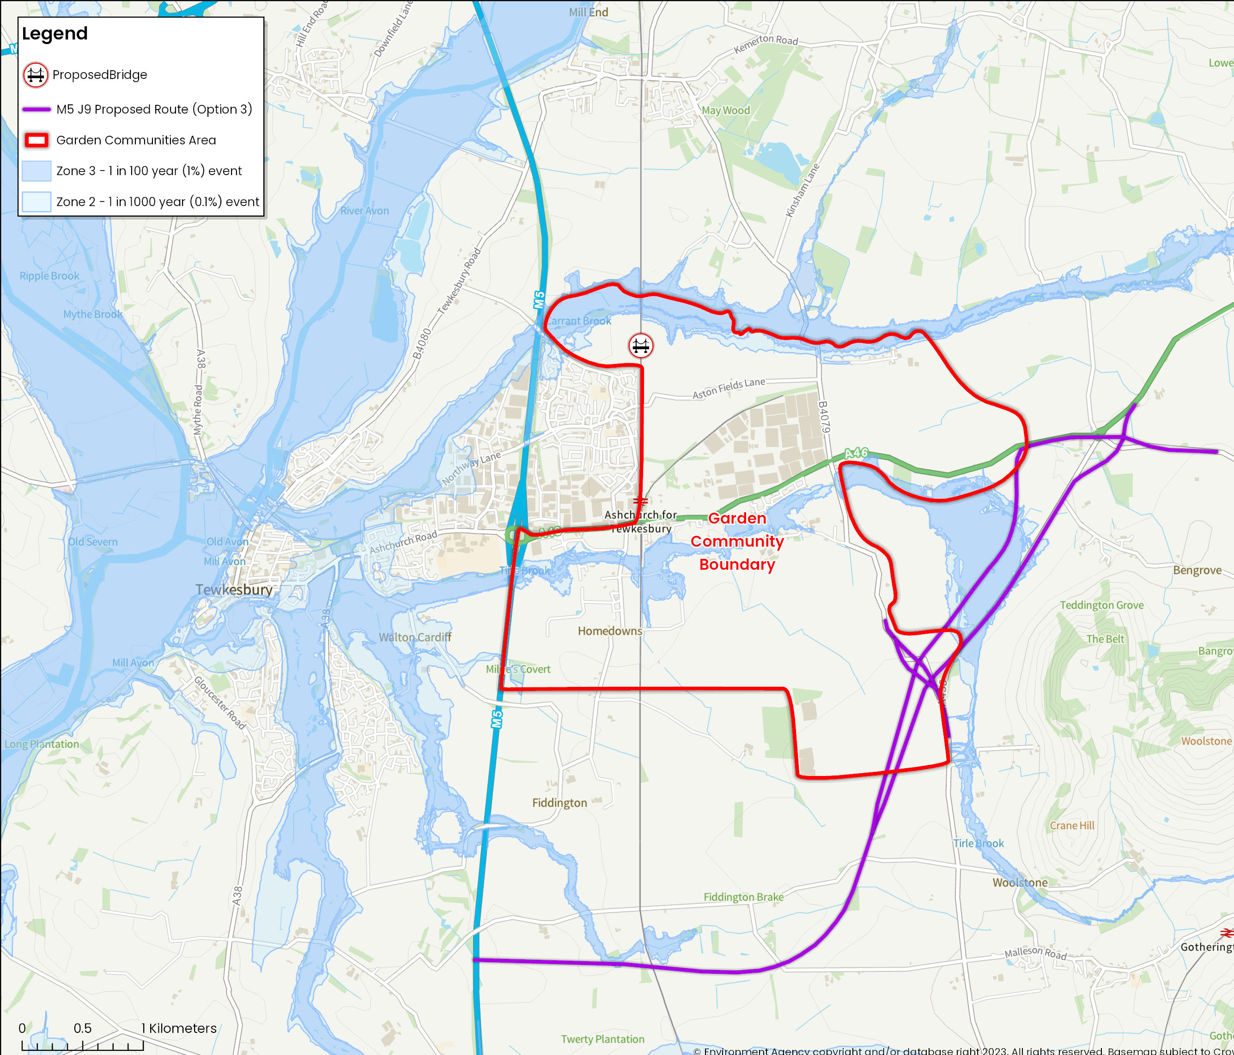
Transport
Northway
Finalise the design
Environmental impact
Site-wide application
When will we be able to see detailed design for the bridge over the railway line, including where exactly this is to be built?
Notes:
A new rail crossing north of the A46 has always been viewed as a key item of unlocking infrastructure for the northern area of the garden communities.
As a result, the borough council recently entered into a conditional sale agreement to purchase land at Northway Court Farm to facilitate bridge delivery, subject to three conditions: a)planning permission is granted for the bridge (being submitted as part of the wider outline application for the northern area), b) that the council secures sufficient funding for construction and c) any other required land parcels are acquired.
Having taken account of the appeal decision to the judicial review in relation to the previous application, the council will not be submitting a planning application to deliver a ‘standalone’ bridge. The responsibility of securing planning permission now lies with the North Ashchurch Consortium as part of their planning application for the broader scheme. An application is expected in 2025.
In December 2024, Homes England granted £89,500 to complete design work on the bridge. This work will also assessthe look of the bridge and is planned for completion in spring 2025.

Slide 26
Agenda
The opportunity
Current pipeline
Transport
The political landscape
Delivery
Stewardship

Slide 27

The political landscape
Move to unitary
Drive for housing growth
Planning reform
Funding re-structure
Unlock growth
Notes:
The new government has unveiled sweeping plans to reform local government and planning with a view to rapidly increase the number of new homes being built across the country. These include enforcing a move to unitary authority for Gloucestershire.
There’s three current proposals, which in summary are a single unitary authority for the whole of Gloucestershire, combining all six districts and the current County council together.
The second proposal is to split east and west, which might see Tewkesbury Borough combined with Cheltenham Borough and Cotswold District, while Gloucester, Stroud and the Forest combine.
And the third option has been dubbed the super doughnut where Gloucester City will take on a few surrounding parishes that are currently form part of Tewkesbury Borough, Cheltenham, Stroud and/or the Forest to grow its population and become a unitary within a unitary as all the “rural” or non-city areas will form a second unitary all around it. Gloucester, so the analogy goes, will in effect be the hole in the super doughnut.
Then there’s the combination of increased house-building targets and planning reform or the NPPF – the National Planning Policy Framework. Literally hundreds of pages of legislation that our planning colleagues have to comply with are being changed in quick time. I have neither the time nor ability to explain it all but we’ll be happy to chat about it all later.
As Cllr Stanley noted in his opening words, some of the planning that we have already seen was won on appeal where Tewkesbury Borough Council as the local planning authority has turned down applications. Where plans don’t meet with the Garden Communities aspirations, Alice has previously been to court to make the case but to no avail, yet. New administration and C.Ex. – change of approach. All the more reason, then, that we plan for the building of new homes, rather than let this happen in an ad hoc way.
Add in section on the 5yls and the charter’s role in “keeping people in line” (RS wording)
To do that we’ve been brilliantly supported by the teams within the Ministry of Housing, Communities and Local Government, including Homes England and their input has been a great help as we map out the delivery of this ambitious programme over the next 30 years or more.
Need to have the land supply and policy in place – working with HE on leverage and control. Policy and SLP – and we’ve set out the vision through the charter.

Slide 28
Agenda
The opportunity
Current pipeline
Transport
The political landscape
Delivery
Stewardship
Notes:
Jonathan, can you delve a little deeper into the delivery aspect for us, please?

Slide 29
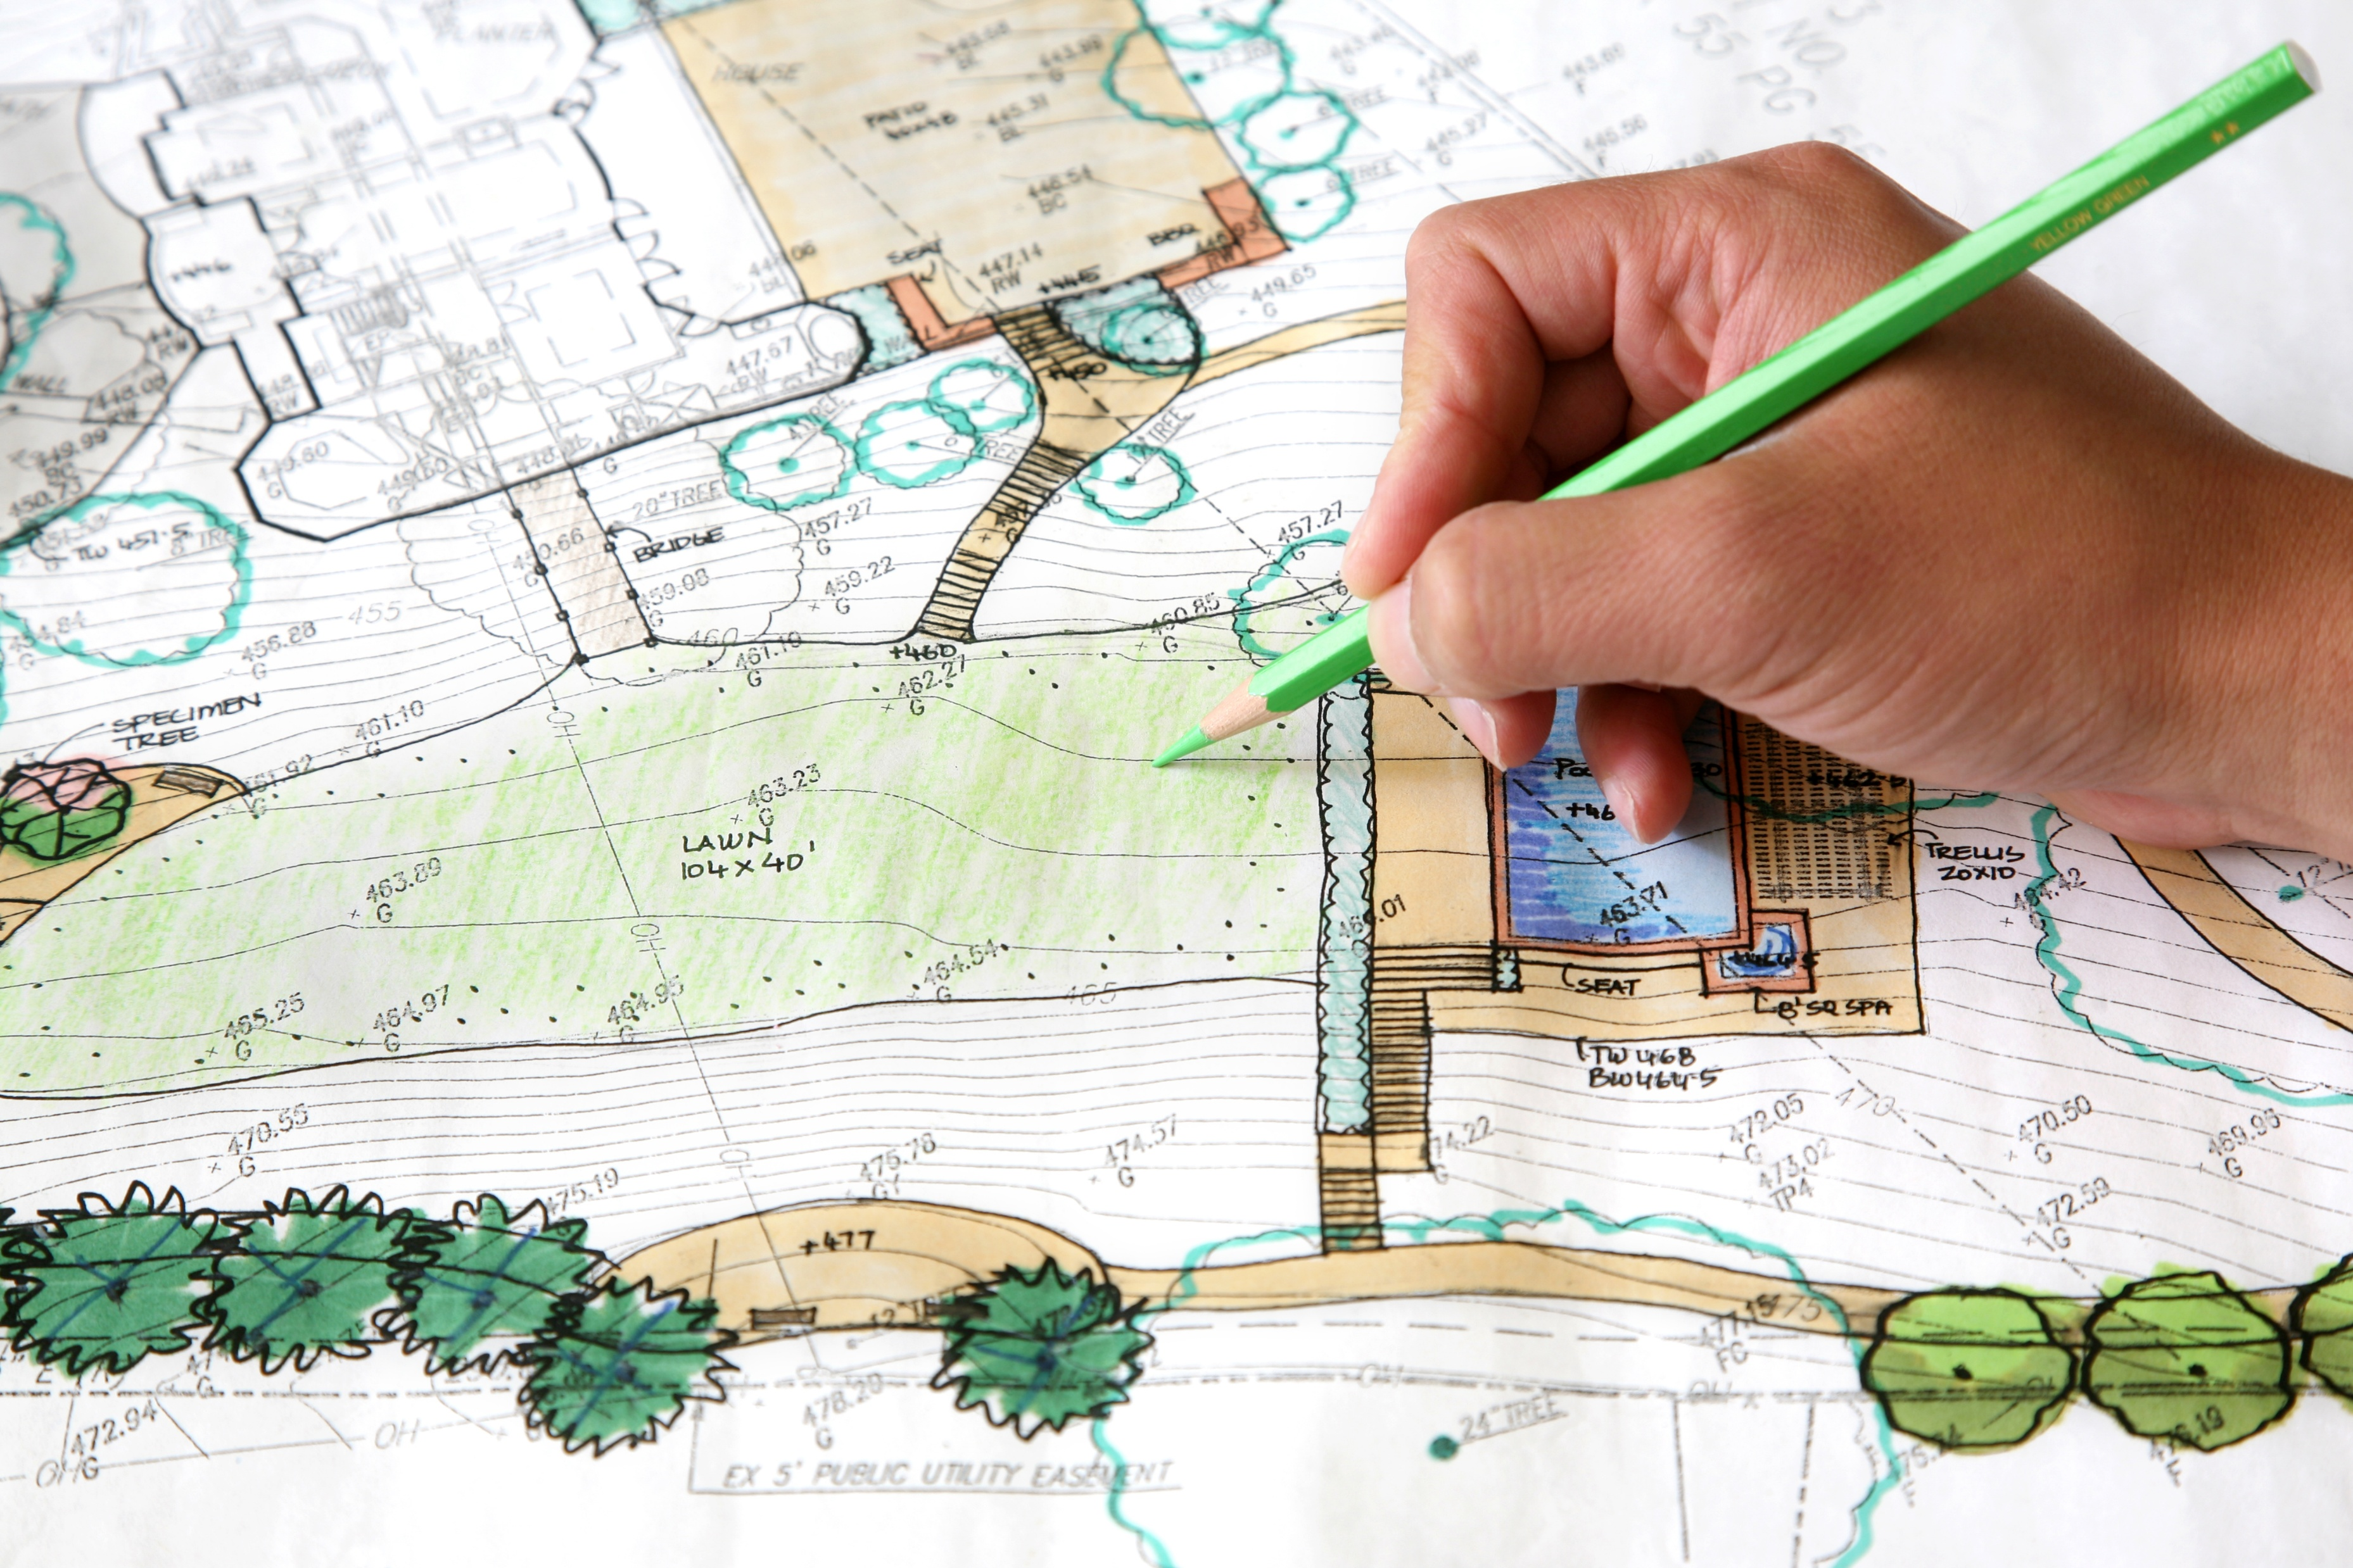

Delivery
Bid for funding
Interim “vehicle”
Employment
Robust legal structure Possible capital funds
Notes:
A strong identity and character of place.
The Garden Communities will be unique, yet rooted to Tewkesbury through use of materials and embracing its art and culture.
Responding to the local character and the borough’s identity as a great place to live and work, development will take influence from the historic character of the area. A new community, with distinct character areas will be created.
We must see:
Existing communities to get involved in the process, sharing understanding of what makes each area unique.
Different scales of public open spaces, connecting communities with nature from major green corridors to small community gardens and green streets.
An understanding of historic landscape character and protection of important natural features. For example, hedgerows, watercourses and field patterns.
Human scale development with streets designed for people, not cars.
A variety of structural styles. These range from tight-knit urban development around the station to new villages that reflect their rural area.
Public buildings such as schools and community centres to be at the heart of each new community.
A clear strategy of how to link the town centre with new areas and addressing the needs of existing communities through new developments.
New development proposals will undergo a Building with Nature assessment
New development proposals will undergo a Building for a Healthy life assessment
New development proposals will be subject to a Design Review.
In September 2024 the council authorised an update to the earlier submission of a bid to MHCLG for funding and support to establish the most effective delivery vehicle to continue the delivery the Tewkesbury Garden Communities.
An interim vehicle (IV) is proposed as a preliminary stage prior to establishing a Locally Led Development Corporation (LLDC). This would require an act of parliament and will take time to put in-place.
The IV would provide an appropriate and robust legal structure and would bring additional resources from central government to support the ongoing delivery especially that of the employment.
It would also potentially provide capital funds for some land acquisition including that of the employment site.
A decision from MHCLG is expected in the coming months.

Slide 30
Agenda
The opportunity
Current pipeline
Transport
The political landscape
Delivery
Stewardship
Notes:
Thank you, Jonathan, the Locally Led Development Company is certainly an exciting prospect and newly restructured Governance groups are going to be vital in ensuring that is well structured.
Once things are ready, though, then we need to ensure that they are well cared for and properly managed. I’m sure we’ve heared the about the parish not a million miles away that specified a

Slide 31

Stewardship
What is it?
Notes:
NB A key principle in the Garden Communities Charter!
Promoting community ownership and longer-term stewardship - the long-term management and maintenance of non-private facilities and services.
Initial meetings have taken place with both Ashchurch Rural (11 Nov) and Northway (11 Dec) parishes to introduce the concept of stewardship at scale for the TGC.
Stewardship in the context of Garden Communities primarily means the long term (notionally in perpetuity) management and care of community assets created through development. Typically this will include (non-adopted) green open spaces, sports and play facilities and community buildings.
It can also include elements of community building and placemaking where the established stewardship organisation is actively involved in community engagement and ‘animation’, organising events, provision of local services (e.g. on-demand local transport), delivering well-being programmes and can stretch as far as supplying utilities and data services and potentially running commercial activities within the community, e.g. cinemas, arts centres, care homes, cafes, pubs etc.
The team have been actively engaging with Homes England and external advisors on how to establish appropriate and sustainable stewardship arrangements over the long term. This included a visit to the Chichester Community Development Trust in November. This will be a significant workstream in 2025 and we have received some initial funding from Homes England to support the initial development of a stewardship strategy.

Slide 32
Stewardship
Stewardship in the context of Garden Communities primarily means the long-term management and care of community assets created through development.
Typically, this will include (non-adopted) green open spaces, sports and play facilities and community buildings.

Slide 33
Stewardship
Stewardship in the context of Garden Communities primarily means the long-term management and care of community assets created through development.
Typically, this will include (non-adopted) green open spaces, sports and play facilities and community buildings.

Slide 34
Stewardship
Stewardship in the context of Garden Communities primarily means the long-term management and care of community assets created through development.
Typically, this will include (non-adopted) green open spaces, sports and play facilities and community buildings.

Slide 35
Stewardship
Stewardship in the context of Garden Communities primarily means the long-term management and care of community assets created through development.
Typically, this will include (non-adopted) green open spaces, sports and play facilities and community buildings.

Slide 36

Stewardship
Long term asset management
Buildings and places
Events and services
Commercial outlook

Slide 37
Your questions
Guests in the room for you to chat to
Some already posted online
Questions submitted

Slide 38
Your questions
Ashchurch
Guests in the room for you to chat to
Some already posted online
Has consideration been given to creating a roundabout at the junction of Northway lane and the park?

Slide 39
Your questions
Ashchurch
Guests in the room for you to chat to
Some already posted online
Will there be better bus services provided as properties are built?
Notes:
Charter Principle: Sustainable wider connectivity.
The character areas will be well connected as well as connected to Tewkesbury Town, ensuring that residents of both places are linked.
The Garden Communities will deliver sustainable travel options, to encourage journeys to be via walking, cycling or public transport.
We must see:
Focus on walking, cycling and improved access to public transport.
Communities that are compact and mixed use, allowing residents to reduce their need to travel long distances.
Attractive walking and cycle routes across the Garden Communities. Plus, better access to local schools and the town centre.
Streets designed for people, not cars. Including a maximum 20mph speed limit throughout the Garden Communities.
Promotion of cycling across the Garden Communities through safe and convenient routes, away from primary roads.
Use of data and local information to support active and sustainable travel.
Infrastructure must be delivered alongside the development of housing.
Development will support the A46 to become a more attractive route for walking and cycling.
The delivery of a strategic traffic solution to reduce existing congestion and support housing and economic growth.
Development must support improvements to Ashchurch for Tewkesbury train station to allow for increased usage as well as improved links to the train station.
Another key principle in the Garden Communities Charter: Integrated live, work, play communities.
The Garden Communities will be an inclusive, desirable place to live, work and play for all ages. Funding from planning gain will help support this.
A new network of neighbourhood centres will be comprehensively designed and planned providing easy access to shops, community facilities and other services such as healthcare.
New employment areas within the development will be accessible by sustainable travel options and will be well connected to new as well as the existing communities.
We must see:
Local live/work units, co-working space and employment sites for high-value sector growth.
Focal points for each community. Such as large village centres with schools, shops and business spaces, to small neighbourhood hubs. These will create a space to meet neighbours and friends, grab a coffee or nip to the shops.
New public green spaces that deliver fantastic play and leisure space for all ages. These will be at the heart of each community.
New health facilities to be accessible for everyone within the Garden Communities.
New primary and secondary schools that allow children to walk and cycle to school.
Improved services from Ashchurch for Tewkesbury station. These will enable sustainable access to other employment centres in the region.
High speed fibre internet access to all properties to support digitalisation.
Accessible and inclusive sports facilities. Facilities should be affordable for residents and support existing clubs in Tewkesbury to grow and thrive.
Employment is an essential part of the Garden Communities and all development will be expected to support the delivery of new employment opportunities.
Accessible and inclusive cultural and arts facilities

Slide 40
Your questions
Northway
Guests in the room for you to chat to
Some already posted online
What long-term provision is in place to develop community integration with the existing population?
Notes:
This is a key principle in the Garden Communities Charter!!
Maintain existing communities alongside the development of new areas, reflecting local character.
The Garden Communities will compliment and connect to the Tewkesbury area. This includes neighbouring settlements and the surrounding landscape.
Tewkesbury is a special place. The Garden Communities must support sustainable growth where possible. The programme will need to add to its success as a vibrant and historic market town.
We must see:
Tewkesbury’s central role in the borough protected and enhanced.
Existing communities becoming engaged in the process.
The protection and enhancement of historic villages and their landscape.
The protection of historic rights of way and improved access to the countryside beyond the Garden Communities.
Travel routes from the Garden Communities to the heart of the town centre.
The protection of mature trees, hedgerows and walking paths.
The creation of major public green spaces around the Carrant and Tirle brooks.
A clear strategy of how to link the town centre with new areas and addressing the needs of existing communities through new developments.

Slide 41

Notes:
Loop the charter slides on this section while people chat!

